Slide 1
Introduction to
Harm Reduction
Harm Reduction Services Team
Jennifer McLaren, RN, Edmonton Zone Lead
Sara Gill, RN, Educator
Notes:
Land acknowledgement; give verbal thanks to traditional stewards of the land where presentation is taking place
Photo: https://www.freepik.com/premium-photo/people-old-young-hand-holding-with-sunset-background_2354160.htm#page=1&index=25&query=helping%20hand

Slide 2
Overview
Psychoactive Substance Use & Risk
Defining Harm Reduction
Principles
Services
Practice
Examples of Indigenous Harm Reduction Services
Questions

Slide 3
“People who use drugs are not expendable – they are human beings who come from families who love them. They are someone’s son, daughter, brother, sister, or parent.”
(BC Ministry of Health, 2005)
Notes:
This is the message that we hope you take with you from this presentation.
In order to truly practice Harm Reduction, a cultural shift will need to happen in some cases. The approach of harm reduction closely follows AHS Values of Compassion, Accountability, Respect, Excellence and Safety.
These values should be at the heart of everything that we do and should inspire and guide what we do when providing for our clients in all circumstances and from all walks of life.
Reference: https://www.health.gov.bc.ca/library/publications/year/2005/hrcommunityguide.pdf

Slide 4
Psychoactive substances
Substances that affect mental processes (i.e., thoughts, behaviour, feelings)
A neutral and descriptive term for the whole class of substances, legal or illegal, and does not imply abuse or dependence

Slide 5
Psychoactive substance use is a global phenomenon
Use of psychoactive substances is a human cultural practice that people have engaged in historically
e.g., mushrooms, opium, cannabis, tobacco, pre- historic plants with psychoactive properties
What benefits do they provide people?
Notes:
One of the main principles of harm reduction is recognizing that substance use is inevitable- it is not something that we will ever eradicate from the world.
It is likely that we have all used or will use psychoactive substances at some point in our lives for the benefits that they provide.
Casual use, dependence, and poisoning can affect anyone and many people use substances without ever becoming chronically dependent.
It’s important to consider why people consume/use/take psychoactive substances
What benefits do they provide people?

Slide 6
Personal Benefit
Social Connection
Loneliness
Chronic Pain
Prescribed Treatment
Self-Medication
Trauma
Availability
Peer Pressure
Self-Discovery
Notes:
Recognizing that people do things for a reason (to meet a need) is so important to providing good care. Simply put, people take substances to feel better.
Harmful health behaviours provide some benefit. Assessing, acknowledging and weighing the risks and benefits help us understand how we can mitigate risks around behaviours. This empowers to present appropriate and
realistic options as service or care providers, family members, friends to people engaging in psychoactive substance use.
e.g., if we explore the motivation to use for someone who is chronically using crystal meth and experiencing homelessness, often we find that people who use crystal meth do so to maintain alertness, to stay awake overnight, to stay safe and mobile when on the streets, where at times people may be assaulted or robbed while asleep
A note on trauma: the experience of childhood trauma is linked to compulsive use of nicotine, alcohol, and injected street drugs (Felitti, 2004).
References
https://www.samhsa.gov/nctic/trauma-interventions
http://www.ccsa.ca/Resource%20Library/CCSA-Trauma-informed-Care-Toolkit-2014-en.pdf
https://www.cdc.gov/violenceprevention/acestudy/index.html (Centre for Disease Control and Prevention CDCP)
Health. 2007;1(2):141–143. Anda RF, Butchart A, Felitti VJ, Brown DW. Building a framework for global surveillance of the public health implications of adverse childhood experiences . AM J Prev Med . 2010

Slide 7
https://www.health.gov.bc.ca/library/publications/year/2004/framework_for_substance_use_and_addiction.pdf
Notes:
Substance use can be viewed on a spectrum. On one end, use can be viewed as beneficial with little negative impact (e.g., drinking coffee) and on the other, people can experience more negative effects on their life due to chronic and compulsive substance use and be diagnosed with a substance use disorder, which some may refer to as addiction.
People can move back and forth along the spectrum at any given time and for any given substance. Many people will use psychoactive substances and never get to the point of a use disorder or great harm, but it is important to note that there is always a potential for overdose or poisoning with psychoactive substance use, especially with fentanyl and any street-made drug, and overdose incidents do not discriminate. They can impact anyone—no matter their race, socioeconomic status, education or profession.
It is also important to point out that the reasons people start to use are not always the same reasons why they continue to use. People with substance use disorders experience changes in brain structure, where they experience reward from compulsive use. Often this reward is simply avoiding very painful withdrawal symptoms.
When it comes to levels of harm and levels of risk we know that, because of the toxic drug supply on the streets, anyone using street-made substances or drugs is at risk of death due to do poisoning or overdose. People using psychoactive substances are often marginalized and stigmatized, with minimal supports—many are afraid to seek help for fear of being mistreated or the negative effects labelling and prejudice will have on their lives and loved ones.
A harm reduction approach can be applied at any point along this spectrum. It is important to understand how someone views their substance use on this spectrum to foster conversations around supports and the plan for care.

Slide 8
Potential risks of harms around substance use
Acquisition
Use
Withdrawal
Indigenous factors
Increased rates of HIV and Hepatitis C infection
Communities are at different levels of readiness to deal with these risks
Abstinence-based model and approach leaves little support for implementation harm reduction strategies
Notes:
Risk doesn’t exist just in using substances, but in acquiring them and in abstaining from them after using for some time.
Risks around acquiring drugs may be related to exposure to situations, such as criminal behaviour (either being exposed to or conducting criminal acts such as drug dealing, robbery, etc.).
Risks around use of drugs depend on the to the drug used, the amount taken, and the method of consumption. Each drug and method has different effects and potential consequences on a person’s health.
e.g, injection use may lead to wounds, infection, poor vein health, and of course, overdose. Factors that influence include purity or potency of the drug, amount taken, duration of its effects, frequency of drug use, how it is consumed, polysubstance use (i.e., combining it with other substances), and physical health
Risks around withdrawal or detoxification from a drug are related to severe discomfort, impaired work and social functioning, a tendency to engage in higher risk activities (e.g., sharing injection supplies, not using full judgment around dosing or using larger amounts than they can tolerate), and criminal behaviours
Some risks are higher for indigenous people.
Rates of infection are increased for HIV and Hepatitis C. These rates are shaped by realities for indigenous communities such as lower socioeconomic status, barriers to accessing health care, discrimination, residential school effects, homelessness, and substance use disorders.
Communities are at different levels or readiness to deal with these risks and there is still a lot of stigma, fear and misinformation
The abstinence-based model and approach can leave little support for implementation of HR strategies in communities. This is changing but for some communities, due to challenges in accessing treatment, abstinence-based models may be the only available option.
Reference: https://www.unodc.org/ddt-training/treatment/VOLUME%20D/Topic%204/1.VolD_Topic4_Harm_Reduction.pdf

Slide 9
Harm Reduction
A continuum of services geared towards a specific target group where one hasn’t existed before
A range of policies, programs, and practices that aim to promote safety and reduce adverse consequences associated with an activity or behaviour through education, prevention, resources, and support for individuals, families, communities or society
Evidence based, cost-effective, compassionate, and ethical
Notes:
HR recognizes that people lead lives of risk and that abstinence from activities that are considered risky is unrealistic or undesirable for some and respects that people will decide their own course and move forward when they are ready
Beyond this, HR can be viewed as a cultural movement, where respect, rights and power is shifted from service providers to the people who use the services. And when we speak of harm reduction, the services we provide are more often than not to people who are underserved, stigmatised and marginalized in society
[Read slide]

Slide 10
https://rnao.ca/sites/rnao-ca/files/Engaging_Clients_Who_Use_Substances_13_WEB.pdf
Notes:
With the common goal of decreasing those negative consequences that come with substance use, HR can be a all of the following:
A concept or way of thinking or viewing drug use in a neutral way, focusing on problems that arise from use rather than insisting on abstinence and respecting a person’s right to choose the course of their life
A policy that outlines this way of thinking and practice in an organization
A practice of providing services in a way that removes conventional barriers (e.g., cost, restrictive hours, location), accepts people as they are, and pragmatically attempts to address risks and support the goals of the person
Programs that serve people who use drugs—we’ll expand on these in a moment
Reference: https://rnao.ca/sites/rnao-ca/files/Engaging_Clients_Who_Use_Substances_13_WEB.pdf

Slide 11
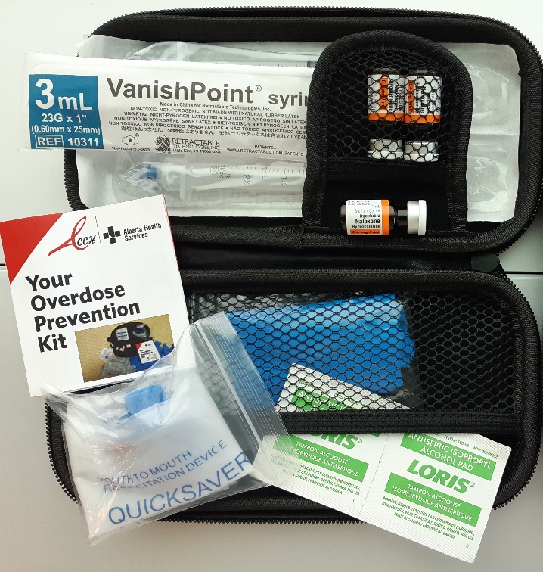
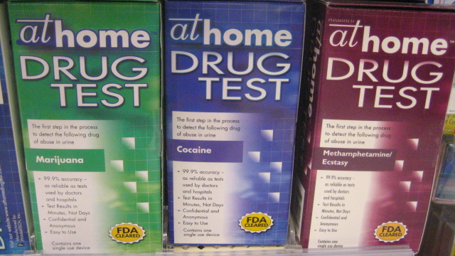
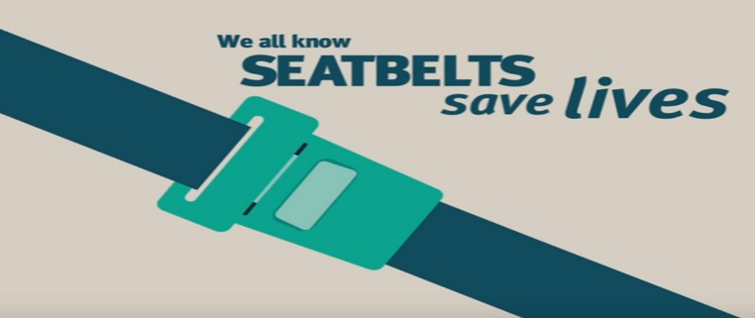
Notes:
Image Sources
Drug Tests: https://www.flickr.com/photos/watz/2413689502
Condoms: https://www.maxpixel.net/Prevent-Prevention-Rubber-Condoms-Condom-3112008
Live Jackets: https://www.flickr.com/photos/deepwaterhorizonresponse/4921381136/in/photostream/

Slide 12
Guiding Principles
Pragmatism
Human Rights
Focus on Harms
Maximizing Intervention Options
Incrementalism
Priority of Immediate Goals
Peer Involvement
Dignity and Compassion
Transparency and Accountability

Slide 13
Excerpt | Walk With Me Pathways to Health
http://caan.ca/wp-content/uploads/2012/05/WalkWithMe_en2.pdf
Notes:
Here is an excerpt from a HR Service Delivery Model developed by the Canadian Aboriginal AIDS Network for indigenous women, youth, people who have been incarcerated or identify as two-spirit.
It highlights values of traditional wisdom, generations of experience, respect and appreciation for everyone, humility, honesty, bravery of those who pursue their right to care and work towards their health goals, loving environments and positive energy, and speaking one’s truth with pride.
This model may be a helpful resource for communities wanting to learn more about how to adapt HR in a way that is best suited for them.
Reference: http://caan.ca/wp-content/uploads/2012/05/WalkWithMe_en2.pdf

Slide 14
Provincial Opioid Crisis Response
Harm Reduction
Community Based Naloxone Program
Expanded Treatment Access
Supervised Consumption Services
Minister’s Opioid Emergency Response Commission
Community Based Needs Assessment
Enforcement
Supervised Consumption
Services
Enforcement
Notes:
These are just some of the current responses happening across the province to address the overdose crisis that is happening.
-SCS
-CBN program
-MOERC- as of July 2018 – have made 32 recommendations
First Nations specific recommendations:
Recommendation 6: make a specific funding opportunity available to Indigenous Communities and organizations who serve Indigenous people for initiatives that address the urgent opioid crisis. The Commission recommends this be achieved through an open call for proposals for interventions that support a specific Indigenous Community or Indigenous people on a broader scale. The funding opportunity should be available for all Indigenous Communities (that is on and off Reserve or Settlement Communities). As appropriate, the Commission suggests that the Indigenous Opioids Advisory Sub-Committee Action Plan could act as a guide for the Community and organization proposals and response.
Recommendation 26: allocate additional funding to the Indigenous specific opioid response. These additional funds are recommended to be used to enhance the proposals for interventions supporting Indigenous Communities (as previously recommended by the Commission) as well as the provision of additional funding for provincial in-scope initiatives.
Examples of awareness grants:
Blood Tribe Opioid Awareness Project: Creating a publication, videos, and billboards related to opioid use that is specific to the Blood Tribe and ongoing opioid crisis efforts
Sweetgrass Youth Alliance: messaging campaign, creating a publication, and holding community information sessions
-Community Based Needs Assessment- funding for awareness campaigns in communities
-expanded treatment options- suboxone in the ED, iOAT, rural ODP, increase in detox/tx beds
-enforcement- Good Samaritan OD act, pill-pressing legislation

Slide 15
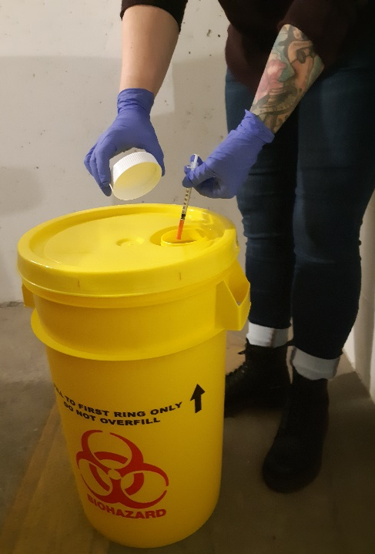
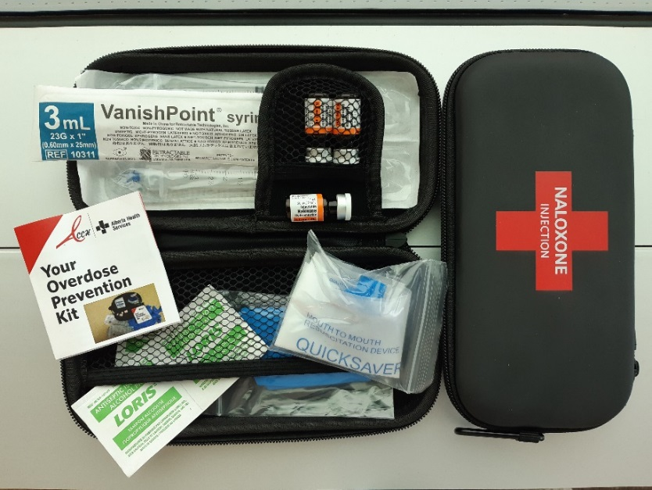
Harm Reduction Programs
Outreach and education
Peer support programs
Supply distribution and recovery programs
Community Based Naloxone Programs
Notes:
Looking at this list, think of the services you can refer your patients to when you know that they are impacted by substance use. Get to know the services and what your patient needs.
CBNP Distribution
Summary statistics (as of November 30, 2018):
1,789 : Number of providers
121,293 : Number of kits distributed
7,240 : Number of reported reversals

Slide 16
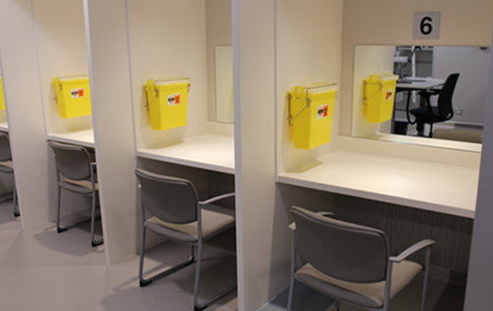
Harm Reduction Programs
Supervised Consumption Services (SCS) and Overdose Prevention Sites (OPS)
Street drug testing and warning systems
Managed alcohol programs (MAP)
Opioid agonist therapy (OAT)
Notes:
Mention ARCH program and examples of all these services

Slide 17
Harm Reduction Challenges
FOR SERVICE PROVIDERS
Client experiences in the past
Staff attitude and communication
Culture change
Behaviours
Moral distress
Policies and systems
FOR CLIENTS
Past experiences
Others not understanding
Stigma
Access
Trust
Policy and systems
Notes:
Moral distress: when one knows the right thing to do, but institutional constraints make it nearly impossible to pursue the right course of action.
For communities:
Stigmas, myths and misconceptions
Drugs and behaviours
Politics
Lack of support
Lack of trust
Lack of funds
For individuals:
Negative attitudes, prejudice, homophobia, racism, sexism
Being judgmental towards target population
Lack of respect for individual choices, fear of change
Health condition
http://www.bccdc.ca/resource-gallery/Documents/Educational%20Materials/Epid/Other/CompleteHRTRAININGMANUALJanuary282011.pdf
Page 21

Slide 18
Benefits of Harm Reduction
Individual
Society
Community
Health
Social
Economic
Notes:
One widely-cited conception of harm reduction distinguishes harm and benefits at different levels - individual, community and societal - and of different types - health, social and economic (Newcombe 1992). These distinctions give a good indication of the breadth of focus and concern within harm reduction.
Source: https://www.hri.global/files/2010/05/31/HIVTop50Documents11.pdf
Health: physical & mental functioning
Social: order/disorder; inclusion/exclusion
Economic: financial costs & gains
Individual benefits (for the substance user):
HIV/Hepatitis C Prevention through decreased sharing of equipment
Decreased Emergency Visits
Decreased overdose deaths and
Connection and referrals to health and social services + treatment programs
Empowerment and Capacity Building (feel more in control)
Restored dignity and self-esteem
Reduced levels of violence (able to use without feeling rushed, or threats of violence)
Improved sexual health practices
Harm reduction services such as needle exchange programs often indirectly result in facilitating access to medical and social services (BC Ministry of Health, 2005). One example of this benefit would be: bacterial infections acquired through non-sterile injection techniques can often result in lengthy and expensive hospital admission; however, with early access to primary health care services a wound can be identified and treated before worsening (Kerr & Wood, 2007).
Community: family, friends, colleagues etc.
Safer communities and neighborhoods
Better understanding of substance use disorders within communities (reduces ‘not in my backyard’)
Restores family and friend connections (no longer sending the message to ‘cut people off and let them hit rock bottom’)
PWUS are encouraged to reintegrate into the community; community feels empowered to welcome them- no longer feel excluded therefore more likely to seek further services
Family and friends feel more supported and less isolated- less stigmatization of those associated with substance users
Societal: organizations, institutions
Safer environments- Reductions in the number of people injecting in public, publicly discarded syringes, and injection-related litter.
Decreased costs to justice system.
Lower healthcare costs (improved usage of primary healthcare services).
Improved population health outcomes (decreased rates of blood-borne infections, decreased mortality and morbidity rates).
Decreased stigma and discrimination
Decreased crime rates (people are able to engage in employment)
https://www.hri.global/files/2010/08/31/24.pdf

Slide 19
Harm Reduction Practice
Reflective Practice
Building Rapport & Trust
Cultural Safety
Gathering Feedback
Awareness & Education
Trauma Informed Practice
Removing Barriers
Process vs. Outcome
Patience
Active & Empathetic Listening
Effective Communication
People-first Language
Notes:
Trauma-informed care parallels harm reduction as it focuses on promoting safety, trustworthiness and transparency, peer support, collaboration, empowerment, choice, and recognizes the client’s personal history.
HR is about PATIENCE and a timely approach.
Be non-judgemental and self-aware
Be patient with yourself and clients
Be realistic in your expectations
Listen well – actively and empathetically
Create an opportunity for the client to think of themselves as part of a community
Focus and build on any positive changes and strengths
Person-first language (Broyles et. al, 2014) and trauma and violence informed care
Remember: you are witnessing their important events and struggles. Take care of yourself.
Communicate effectively and listen actively, being open and honest
Build rapport and trust with clients and the community
Use trauma-informed care or practices, which are founded on the goal to preserve a sense of safety, dignity and respect
Build awareness and provide education about prevention, care, and social services for STBBIs, substance use, and homelessness
Ask for feedback
Practicing reflectively and neutrally—free of judgment
Focusing and building on any positive changes and strengths i.e., process vs. outcome (e.g., if treatment to achieve sobriety is someone’s goal, recognizing that the process of setting this goal and moving through the steps of getting to treatment like queuing for detox (which has limited space), remaining in detox for x days, identifying a program that they are interested in getting into are all achievements regardless of whether the outcome of sobriety is attained)

Slide 20
Trauma and Violence Informed Care
Focus on promoting a sense of safety, control and trust
Every effort made to avoid re-traumatization
Asking for permission before any intervention to build respect and increase person’s control of environment and interaction
BCCEWH Trauma Informed Practice & the Opioid Crisis
http://bccewh.bc.ca/wp-content/uploads/2018/06/Opioid-TIP-Guide_May-2018.pdf
AHS Trauma Informed Care e-Learning Modules:
https://www.albertahealthservices.ca/info/page15526.aspx
Notes:
In the face of pain, distress and trauma, substance use is one way people cope. Trauma is an experience that overwhelms a person’s capacity to cope and interferes with sense of safety, self-efficacy, and ability to regulate emotions and navigate relationships. Some examples of trauma may be adverse childhood experiences of abuse, neglect, loss, or natural disasters, violence, war, and internalized stigma and hate.
The Adverse Childhood Experiences (ACE) study is one of the largest investigations conducted to assess associations between childhood trauma and later-life health (CDCP, 2012) Researchers found that compulsive use of nicotine, alcohol, and injected street drugs increases proportionally in a way that parallels the intensity of adverse life experiences during childhood (Felitti, 2004).

Slide 21
Cultural Safety
Based on the principle that people receiving care decide what is safe and unsafe
People are experts in their own lives and we as care/service providers give them control and power to decide their care
Practices include active listening, transparency, mutual learning, and recognition of stigma, lived experience, and how history and politics contribute to how people view and experience the world
Cultural Sensitivity Quick Reference Sheet
https://www.albertahealthservices.ca/assets/info/amh/if-amh-ecc-cultural-sensitivity-qrs.pdf
Creating Culturally Safe Care in Hospital Settings for People who use(d) Illicit Drugs
https://www.uvic.ca/research/centres/cisur/assets/docs/bulletin11-creating-culturally-safe-care.pdf
Notes:
Culturally safe care is complementary to harm reduction in that it fosters engagement and participation of people in shaping their care. This is done through active listening and acknowledgment of concerns and needs; transparency and openness about patient rights and what to expect in care; seeking opportunities to learn from patients (about their lives, needs, preferences and perspectives).
Culturally safe care also recognizes that lived experiences and history and politics have contributed to how people may view the world, and specifically substance use. It requires care providers to reflect on their own attitudes and beliefs about substance use and how drug policies may have shaped them. It builds on this awareness by promoting awareness about the environment of care for patients who use substances—ensuring that they are free of threat of criminalization; allow for privacy and timely discussions about substance use; ensuring appropriate management of pain rather than assumptions that people are drug-seeking; ensuring staff are trained in withdrawal management; providing access to harm reduction supplies; and providing opportunities for staff to learn about stigma and how to recognize their own stigma and reduce stigma.
Culturally safe care recognizes that trauma, violence, layers of disadvantage and stigma affect people’s ability to engage with care providers. Some things care providers can do to support engagement, relationship and trust can include explaining actions and decisions with rationale in order to give patients control over their own health; being flexible, adaptable and extra supportive with options and decisions making; recognizing that anger, frustration, and hostile behaviour stems from life situations and are not personal attacks. Asking the patient if they feel safe can open the door to the patient’s perspectives.
Education on trauma and violence informed care aligns with the practice of culturally safe care.
Reference
Pauly B, McCall J, Browne, AJ, Mollison, A. (2013). University of Victoria Centre for Addictions Research of BC. Bulletin # 11: Creating culturally safe care in hospital settings for people who use(d) illicit drugs. Retrieved from https://www.uvic.ca/research/centres/cisur/assets/docs/bulletin11-creating-culturally-safe-care.pdf

Slide 22
Stigma
Negative attitudes or beliefs about a person/group that are based on fear, ignorance, misunderstanding, and misinformation
Can exist on multiple levels
Impacts how people feel about themselves and decision to follow through or seek care
structural
internalized
compounded
enacted
perceived
Notes:
Stigma plays a role in preventing quality care delivery and creates a barrier for acceptance of harm reduction into practice. We as care providers may internalize stigma through pre-existing policies, experiences and the criminalization of people who use substances. We may be challenged to acknowledge and address our own stigma. Sometimes it is not until we are in a situation that we have never been in before that our stigma or biases come out.
For people who use substances (PWUS), stigma is apparent in
Everyday conversation
Media imagery and publications
Interactions with service providers (e.g., health care, first responders, government)
Service structures that limit participation or involvement of PWUS (e.g., abstinence as inclusion/eligibility criteria)
Cultural beliefs
Affects how people feel about themselves and the way others see them. They internalize the stigma that is enacted towards them. This brings out fear, anger, shame, rejection, hopelessness, grief, distress, isolation, and helplessness for PWUS and their families. Often the messages they hear about themselves become their truth and prevent them from reaching out for help due to feeling unworthy of care and respect.
Reference: https://www.canada.ca/en/health-canada/services/substance-abuse/prescription-drug-abuse/opioids/stigma.html

Slide 23
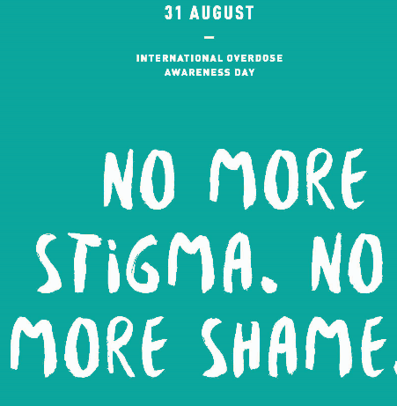
We can reduce stigma by…
Being aware of our own values, beliefs, and behavior and being open to change
Changing the way we speak
Advocating for people who use substances and their families when we see them being spoken to and treated in a disrespectful way, and educate others about stigma
Notes:
Being aware of our own beliefs and values is an important first step. What do we believe or how do we feel about people with substance use disorder and why? Where do our beliefs come from? What do we think of our patients or clients who use substances? How does this affect our interactions with them? We may not be aware of our own values or belief systems until we are facing a situation that challenges us. Be curious. Knowing how our biases might affect the care we provide clients can help us be more mindful of our care. Practicing this critical self-reflection is important. We ought to ensure that our care is neutral and free of our own expectations and intentions for clients, and that every client who uses substances is presented with care options and opportunities that any other client would. Make a habit of self-reflection; when you feel upset about something that happened with a patient, ask yourself why.
Insight is important to reflection—knowing you role, responsibility, duty.
Be open to change, if you recognize biases in your practice and interactions. It is never too late to learn and be better. As the previous story told, the nurse reflected on the events that unfolded with the patient and their husband and examined their responses and resolved to change their practice in the future.
Identify and speak to the person first and not their substance use. Address clients by their preferred name, not their diagnosis. We want to emphasize humanity over condition. We have a habit of referring to people by the symptoms or conditions that brought them into our care, like, “cancer patients” or “diabetics,” but we now see the negative impact that this has had on some of our most vulnerable and marginalized clients as they come into our care and are labelled and identified by their substance use and often are presented with care with many limitations due to stigma. Speaking to the person first recognizes that our clients who use substances are people and not stereotypes. Practice saying “Mr. Doe, who is here for pain” or “Ms. Doe, who is in for opioid poisoning.”
As with any client, we want to know their story. What brought them to seek care? What is important to know beyond their symptoms? Substance use is only one part of their life and a compassionate lens often reveals their story.

Slide 24
Language Matters
Use neutral and medically accurate terms to describe substance use
Use “people-first” language that focuses on the person first, not their actions or condition
Use respectful, caring, compassionate, positive language
Avoid slang and words used to imply something different than the literal definition (e.g., “clean”)
Respectful language is evolving as we become more aware of how our words and actions impact others
Addict
Junkie
User
Abuser
Misuse
Dirty
Clean
PERSON
Notes:
The language and words we use matter and have great impact. Words like addict, junkie and user dehumanize and convey judgment. They deter clients and create barriers for relationships. It is important to note that a person with lived experience may use these terms to describe themselves, and that is their right. However, we as care providers should adhere to using compassionate, respectful language.
When you don’t know what language to use, it is ok to ask your client/patient. It’s ok to be uncomfortable and it’s ok to share it. Vulnerability is appreciated and helps foster rapport. PWUS often feel vulnerable in our care and their strength and commitment to care should be acknowledged positively.
We want to use neutral and medically accurate terms to describe substance use.
Instead of substance or drug abuse, misuse, or problematic use, we want to say substance or drug use, dependence, or substance use disorder if it is a diagnosed condition.
We want to use “people-first” language that focuses on the person first, not their actions or condition
Instead of the word addict, junkie, drug user or abuser, we want to start with the person first and say people who use drugs or people who use substances, people with substance use disorder, people with lived or living experience, people who occasionally use drugs, people actively using drugs.
When referring to people who are no longer using, we should avoid using the word “clean,” and instead refer to their state as sobriety, recovery, abstinence or lived experience.
We want to use respectful, caring, compassionate, positive language.
Instead of “relapse,” which can be a very heavy and negative word for people who have experienced it, we can refer to it as “returning to use”
We want to avoid slang and words used to imply something different than the literal definition.
Do not refer to people who are no longer using as “clean” as this implies the opposite—that they are dirty—when they are using.
Referring to a negative urine drug screens as “clean,” and a positive as “dirty” is equally stigmatizing. Instead, we should use diagnostic terms that are neutral and explicit, like negative and positive.
Respectful language is evolving as we become more aware of how our words and actions impact others

Slide 25
“The opposite of addiction isn’t sobriety. It’s connection.” - Johann Hari
Notes:
There is a common misconception that people need to hit rock bottom before they can accept help. Harm reduction really emphasizes the value of human connection. Of fostering supportive relationships and leaving doors open for people to access services and ask for help when they are ready.
It is better to focus efforts on preventing someone from hitting rock bottom through education, prevention, and compassion so that they don’t get to a state of crisis.
e.g., Someone with heart problems would not be left until they were in a critical state before receiving care. It would be expected that care providers would address some preventative measures (like diet, smoking cessation, medication, exercise, stress reduction) in order to reduce the likelihood of an unfortunate event in the future.
Image Source: DJ EFX Let’s Join Hands Album, Future Funk Media

Slide 26
Fostering Connection
Everyone deserves to feel safe, respected and treated with dignity
Set healthy boundaries for relationships
Establish safety plans for use, storage, and disposal of harm reduction supplies
Have open and honest conversations about substance use in a respectful and compassionate way in order to identify needs and goals of people accessing services (i.e., ask questions and avoid making assumptions)
Notes:
Safety is very important; however, research shows that a respectful harm reduction approach and a trusting relationship with the patient supports a safe environment for both the staff member and the patient. Harm reduction approaches and interventions such as having a non-judgmental attitude, providing harm reduction supplies and safe, monitored spaces for drug use, and adequately treating pain and withdrawal, all contribute to the creation of a safe environment for everyone.
Realistic and respectful boundaries are an essential component of harm reduction. It is possible (and necessary) to set healthy limits on problematic behaviour while maintaining a compassionate and respectful attitude
It is also important to set boundaries for ourselves. Remember that we cannot do everything for everyone and that we have limits and need to care for ourselves. It is important to build capacity in our community members and partner with other services to work collaboratively to support community members in need.
Set healthy limits for your involvement and disclosure. Failure to maintain appropriate boundaries may result in unsafe work environments, provider burnout, inappropriate and unethical intimate relationships between care providers and patients, and damaged trust.

Slide 27
Harm Reduction in
Indigenous Communities
Notes:
- Provide examples of other communities

Slide 28
Culturally Appropriate
Community education efforts and training for all
Recognize perceptions and barriers
Respect age and literacy levels of clients
Provide additional services
Notes:
Landry, M., MD, Veilleux, N., MD, Arseneault, J., MD, Abboud, S., MD, Barrieau, A., MD, & Bélanger, M. (2016). From: https://www.ncbi.nlm.nih.gov/pmc/articles/PMC5047842/
Wardman, D., & Quantz, D. (2006).
Harm Reduction in First Nations communities must be culturally appropriate.
Areas to consider:
The most important element of developing and providing HR services is to integrate cultural practices. For example, oral traditions and story-telling can allow individuals to share their experiences and allow other community members to learn and build compassion for individuals using substances.
Educating all community members helps develop acceptance of culturally respectful health care delivery. The entire community needs to be provided with information.
Need to take into consideration differences in age and literacy levels- Younger clients may prefer a more direct style of communication whereas older generations may find it inappropriate to discuss issues directly.
Need to strongly consider incorporating additional services in conjunction with harm reduction (providing only a needle exchange program without additional education, counseling and other health services can be ineffective). Should attempt to integrate into new and existing programs.
Recognize potential perceptions and barriers to implementing harm reduction services in the community:
Identified barriers for clients in using HR services:
the stigma attached to both addictions and, concurrently, the use of HR services by those with addictions.
Accessing HR services can have a stigma of failure attached to it and is viewed by some as the last option after other treatment modalities have failed. For many service providers and community members, there is a sense of giving up when individuals continue to use substances.
fear of a lack of confidentiality when they access these services. Whether this fear is real or not is unclear but some clients are reluctant to access services within their community for fear of being identified.
may also be a lack of support for HR services in terms of policies or management. A reluctance to support HR services from boards or management due to political or philosophical reasons were noted as an issue for many communities

Slide 29
Friendship Centres
“Point of contact for information, cultural programming and services and referrals for an increasing number of urban Indigenous people across Alberta.”
Joanne Mason, Executive Director,
Alberta Native Friendship Centres Association
Elders, health care providers and people with lived experience provide guidance on traditional and culturally appropriate approach to supporting individuals affected by substance use
Navigators have been hired in Edmonton, Calgary, Lethbridge and Grande Prairie to connect people to treatment, harm reduction and culturally sensitive wraparound services
Notes:
https://www.alberta.ca/release.cfm?xID=5853540C34502-9788-91F6-CD91F84EB23ACCF6#media-contacts

Slide 30
AHS Indigenous Health Program
Notes:
Provides accessible and culturally appropriate health services for indigenous people in Alberta
Also provides cultural and spiritual support to patients and families, collaborates with health care providers around spiritual, cultural and other special needs to facilitate culturally safe and family-centred care
Provides advocacy and support for navigating health care system
Website lists all services by location and many other indigenous health resources
Work is guided by the advice of the Wisdom Council

Slide 31
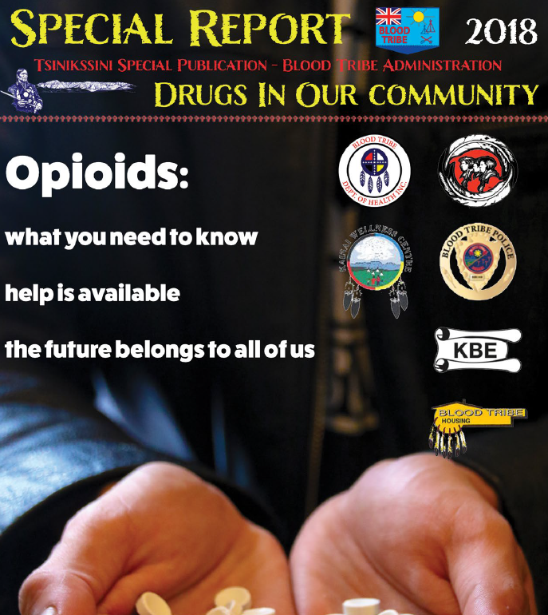
Blood Tribe
http://bloodtribe.org/wp-content/uploads/2018/11/Drug-Magazine.pdf
http://bloodtribe.org/wp-content/uploads/2018/11/Drug-Magazine.pdf
Notes:
http://bloodtribe.org/wp-content/uploads/2018/11/Drug-Magazine.pdf
In the South of Alberta, Blood Tribe has developed a comprehensive HR program, and some of their activities include:
1. Continue naloxone training and addictions workshops
2. Continue distribution of ‘safe use’ supplies
3. Support and encourage peer support groups
4. Link motivated clients with traditional supports and life skills programs
5. Continue and enhance education through PR:
* Build Internet presence
* Distribute information through newspapers, fliers, posters, radio.
6. Continue to provide emergency transportation and Help-line access.
7. Develop ‘support team’ to focus on ‘high risk individuals and families.’
8. Continue to develop programs to help with non-pharmacologic
management of stress and pain: yoga, counseling, drum circles, low-risk medication
9. Community projects: environmental cleanup and gardens.
10. Nurture and develop partnerships with community organizations

Slide 32
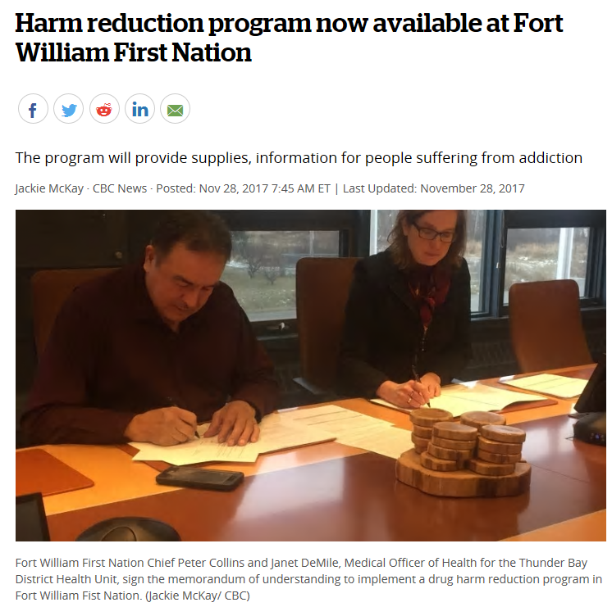
Chippewas of the Thames First Nation
http://anishinabeknews.ca/2018/09/12/chippewas-of-the-thames-first-nation-launch-harm-reduction-program/
https://www.cbc.ca/news/canada/thunder-bay/fort-william-first-nation-harm-reduction-1.4421962
Notes:
three adjacent First Nations in southwestern Ontario- COTTFN provides mobile supply distribution, education on safer substance use, naloxone kits, and support with treatment. Their harm reduction program includes the use of the traditional medicines sage, cedar, and sweetgrass. The article noted that this component has brought a real connection for some of the team’s clients, allowing them to open up emotionally.
http://anishinabeknews.ca/2018/09/12/chippewas-of-the-thames-first-nation-launch-harm-reduction-program/
-new harm reduction service is available in Fort William First Nation (FWFN) in Ontario.
A partnership with the Thunder Bay Health District allows for syringe distribution and recovery, safe inhalation kits for those who smoke, naloxone kits and education. They will establish a fixed harm reduction site at the Fort William Health Centre, where supplies can be accessed. This also gives people a place to access resources if they choose to get help by reducing the stigma associated with being a someone who uses drugs.
https://www.cbc.ca/news/canada/thunder-bay/fort-william-first-nation-harm-reduction-1.4421962

Slide 33
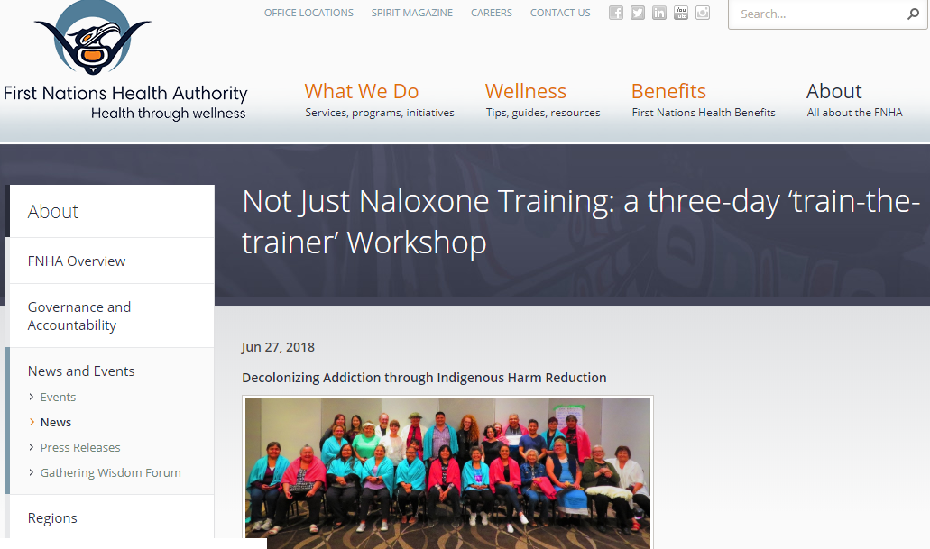
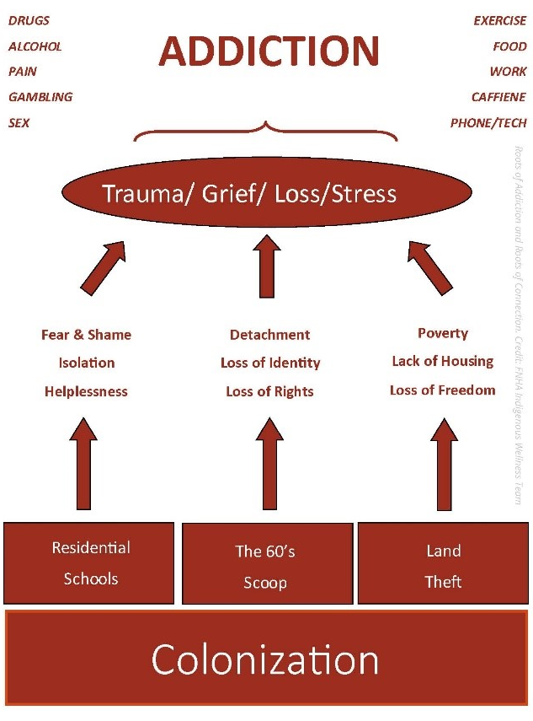
Not Just Naloxone Training in British Columbia
http://www.fnha.ca/about/news-and-events/news/not-just-naloxone-training-a-three-day-train-the-trainer-workshop
Notes:
Diagrams from work in BC.
FNHA's Indigenous Wellness team in BC created these roots of addiction and roots of connection diagrams as part of their “Not Just Naloxone workshop” The workshop was aimed at shifting the focus to the deeper roots of this crisis.
This response uncovers and addresses the roots of addiction, acknowledges the roots of community connection, and empowers First Nations communities to design their own response to the issue—all while celebrating community and individual resilience.
According to FNHA, Indigenous Harm Reduction is built on the foundation that reducing harm is not a new concept to Indigenous communities. Coming from a foundation of care and support, many communities have already been practicing harm reduction, as they work to include and involve the people that they care for who are using substances.
http://www.fnha.ca/about/news-and-events/news/not-just-naloxone-training-a-three-day-train-the-trainer-workshop
Roots of Addiction and Roots of Connection. Credit: FNHA Indigenous Wellness team

Slide 34
First Nations Health Authority in British Columbia
http://www.fnha.ca/wellnessContent/Wellness/FNHA-Indigenous-Harm-Reduction-Principles-and-Practices-Fact-Sheet.pdf
Notes:
http://www.fnha.ca/wellnessContent/Wellness/FNHA-Indigenous-Harm-Reduction-Principles-and-Practices-Fact-Sheet.pdf
The Indigenous Wellness Program at First Nations Health Authority developed ‘Indigenous Harm Reduction’ principles and practices as a learning diagram to host conversations regarding addiction and harm reduction.
Indigenous Harm Reduction is a process of integrating cultural knowledge and values into the strategies and services associated with the work of harm reduction. The learning model reflecting animal teachings and values to support sensitive conversations around addictions and harm reduction through an Indigenous lens.

Slide 35
Safer Substance Use
Use at an SCS, OPS, or with others. Avoid using alone.
Start low and go slow. Do a small test dose before proceeding with use.
Use one substance at a time. Avoid mixing substances.
Know your tolerance and be mindful of health status changes.
Know the signs and symptoms of overdose and call 911 if you suspect it.
Carry a naloxone kit and know how to recognize and respond to suspected opioid overdose.
Notes:
If you have to, have someone check in on you and call for help if needed.
If choosing to mix (and aware of risks), use less and go slow. Beware of drug interactions (alcohol, Rx, cannabis, street drugs)
Tolerance is lower if using for the first time or if it has been some time, and being ill can increase risk of poisoning.
We use the term “poisoning" because it is a technically accurate diagnostic term for what's happening inside the body.
“Overdose," means "to administer medicine in too large a dose," and implies that the person using the substance knows what the dose is, and chooses to take too much, which is not the case street opioid varieties.

Slide 36
“When we talk about harm reduction, we often reduce it to a public health framework, [one of] reducing risks…
That’s harm reduction with a small ‘h-r’.
Harm reduction is meeting people where they are but not leaving them there.
But Harm Reduction with a capital ‘H’ and ‘R’—this is the movement, one that shifts resources and power to the people who are most vulnerable to structural violence.”
With permission from Monique Tula and credit to Daniel Raymond, Harm Reduction Coalition
from https://filtermag.org/2018/10/19/the-harm-reduction-movement-bigger-than-ever-but-facing-threats/
Notes:
Often mentioned with the phrase “meeting people where they are at,” harm reduction respects a person’s right to choose to live at risk, while maintaining connection and support through education, engagement and unconditional positive regard.
It recognizes the inherent value of human beings and how relationships impact health and care delivery. We accept people as they are with an open door through which people can begin to establish trusting relationships to access the care and support they may need.
Harm reduction can be incorporated and adapted into indigenous communities
Stigma can cause harm and death when people who use substances are afraid to access care and support services due to shame and trauma

Slide 37
Contact Us
harm.reduction@ahs.ca
naloxone.kit@ahs.ca

Slide 38
Resources
Drugsafe.ca | www.drugsafe.ca
Community Based Naloxone Program | www.ahs.ca/naloxone
AHS Opioid Treatment Information | www.albertahealthservices.ca/services/odp.aspx
AHS Indigenous Health Program | www.albertahealthservices.ca/info/Page11949.aspx
Alberta Addicts Who Educate and Advocate Responsibly (AAWEAR) | www.aawear.org
Alberta Community Council on HIV (ACCH) | www.acch.ca
Alberta Native Friendship Centres Association | www.anfca.com
Government of Canada Opioid Crisis & Drug Prevention Campaign | www.canada.ca/en/services/health/campaigns/drug-prevention.html
Government of Alberta Opioid Crisis Response | www.alberta.ca/alberta-opioid-crisis-response.aspx
Thunderbird Partnership Foundation | www.thunderbirdpf.org
Notes:
Friendship Centres – provide services to urban communities that are centred around culture and
Thunderbird Partnership Foundation – networks, conducts research and develops guidelines and best practices for community prevention programs and treatment centres, also provides training, and a continuum of care for indigenous people in Canada.

Slide 39
References
BC Harm Reduction Strategies & Services. (2011). Harm Reduction Training Manual. Retrieved from http://www.bccdc.ca/resource-gallery/Documents/Educational%20Materials/Epid/Other/CompleteHRTRAININGMANUALJanuary282011.pdf
BC Harm Reduction Strategies & Services. (2018). Harm Reduction Services. Retrieved from http://www.bccdc.ca/our-services/programs/harm-reduction
BC Ministry of Health. (2005). Harm Reduction: A British Columbia Community Guide. Retrieved from https://www.health.gov.bc.ca/library/publications/year/2005/hrcommunityguide.pdf
BC Ministry of Health. (2004). Every Door is the Right Door: A British Columbia Planning Framework to Address Problematic Substance Use and Addiction. Retrieved from https://www.health.gov.bc.ca/library/publications/year/2004/framework_for_substance_use_and_addiction.pdf
BC Centre for Disease Control. (2015). HealthLinkBC Understanding Harm Reduction: Substance Use. Retrieved from https://www.healthlinkbc.ca/hlbc/files/documents/healthfiles/hfile102a.pdf
Canadian Aboriginal AIDS Network. Walk With Me Pathways to Health: Harm Reduction Service Delivery Model. Retrieved from http://caan.ca/wp-content/uploads/2012/05/WalkWithMe_en2.pdf
Canadian Research Initiative in Substance Misuse. (2018). Safety Bulletin: Avoid the use of withdrawal management as a standalone treatment. Retrieved from https://crism.ca/wp-content/uploads/2018/03/CRISM-WDM-bulletin.pdf

Slide 40
References
Government of British Columbia. (n.d.). Glossary. Retrieved from https://www2.gov.bc.ca/assets/gov/overdose-awareness/overdose_prevention_glossary.pdf
Harm Reduction Coalition. (2018). Harm Reduction Principles. Retrieved from https://harmreduction.org/about-us/principles-of-harm-reduction/
Hawk, M., Coulter, R.W.S., Egan, J.E., Fisk, S., Friedman, M.R., Tula, M., & Kinsky, S. (2017). Harm reduction principles for healthcare settings. Harm Reduction Journal. Retrieved from https://doi.org/10.1186/s12954-017-0196-4
Hunt, N. (2003). A review of the evidence-base for harm reduction approaches to drug use. Retrieved from: https://www.hri.global/files/2010/05/31/HIVTop50Documents11.pdf
Landry, M., MD, Veilleux, N., MD, Arseneault, J., MD, Abboud, S., MD, Barrieau, A., MD, & Bélanger, M. (2016). Impact of a methadone maintenance program on an aboriginal community: A qualitative study. Canadian Medical Association Journal Open, 4(3), E431-E435.
Pauly B, McCall J, Browne, AJ, Mollison, A. (2013). University of Victoria Centre for Addictions Research of BC. Bulletin # 11: Creating culturally safe care in hospital settings for people who use(d) illicit drugs. Retrieved from https://www.uvic.ca/research/centres/cisur/assets/docs/bulletin11-creating-culturally-safe-care.pdf
Wardman, D., & Quantz, D. (2006). Harm reduction services for British Columbia's first nation population: A qualitative inquiry into opportunities and barriers for injection drug users. Harm Reduction Journal, 3(1), 30-30.

